Slide 1
ThermoBank
Nikolas Pham, Darina Aloff, Kareem Hinton, Viktoriya Rasuli

Slide 2
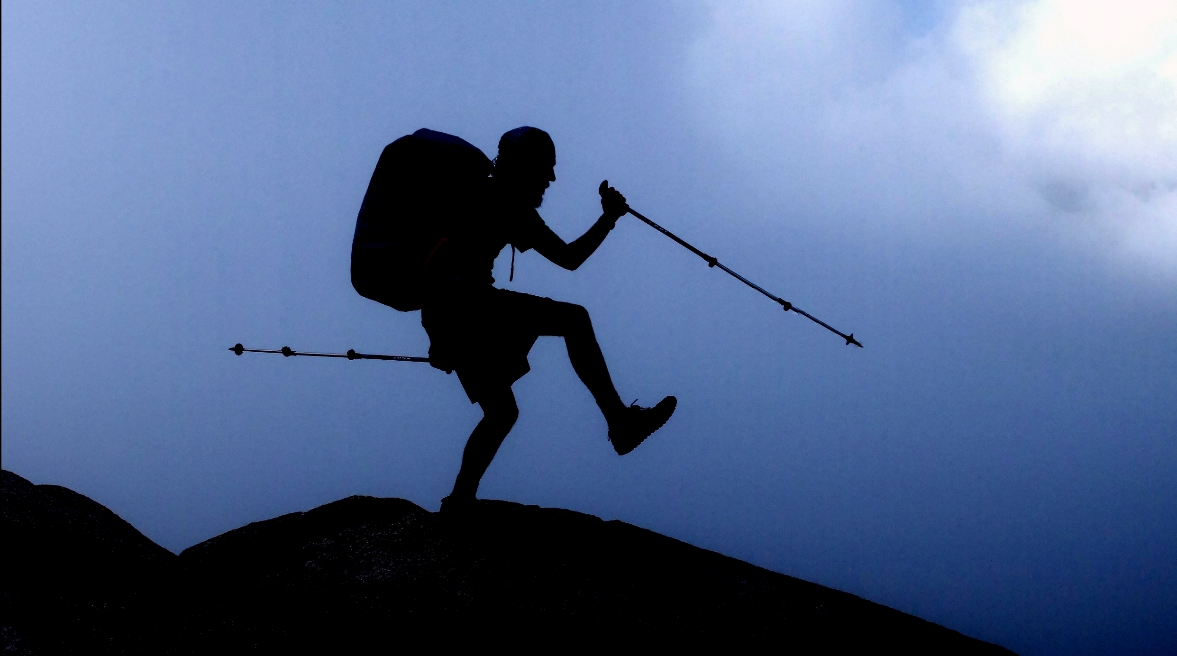
Hikers
Add your first bullet point here
Add your second bullet point here
Add your third bullet point here

Slide 3
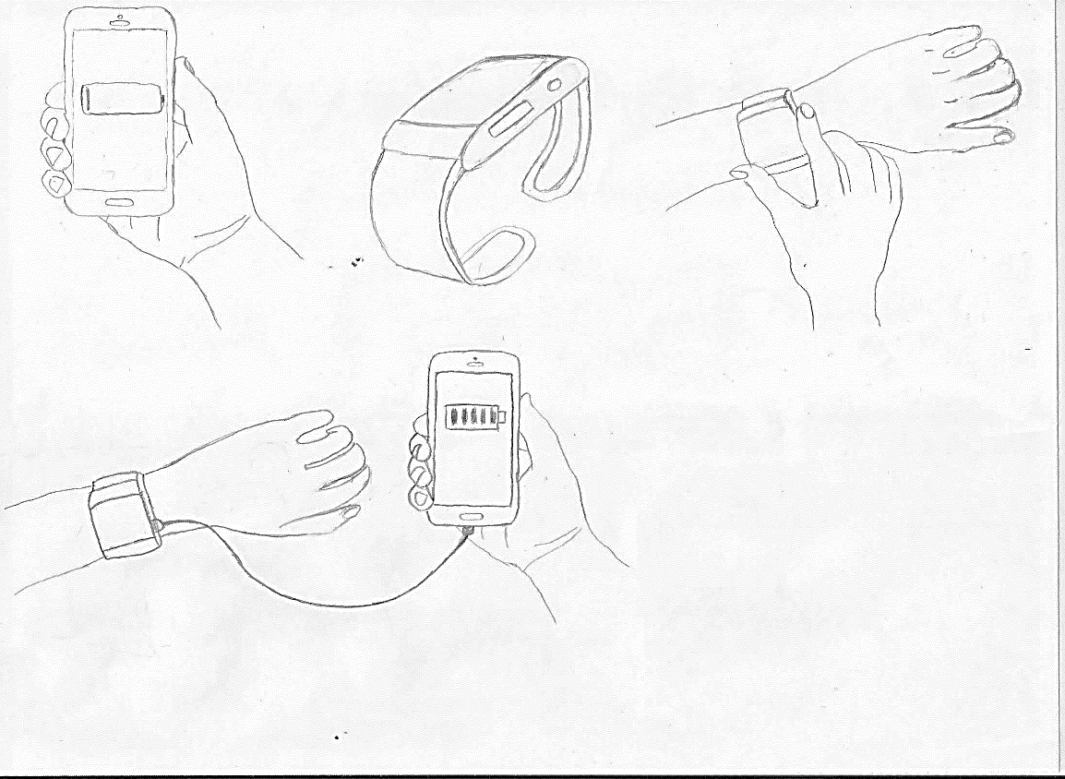
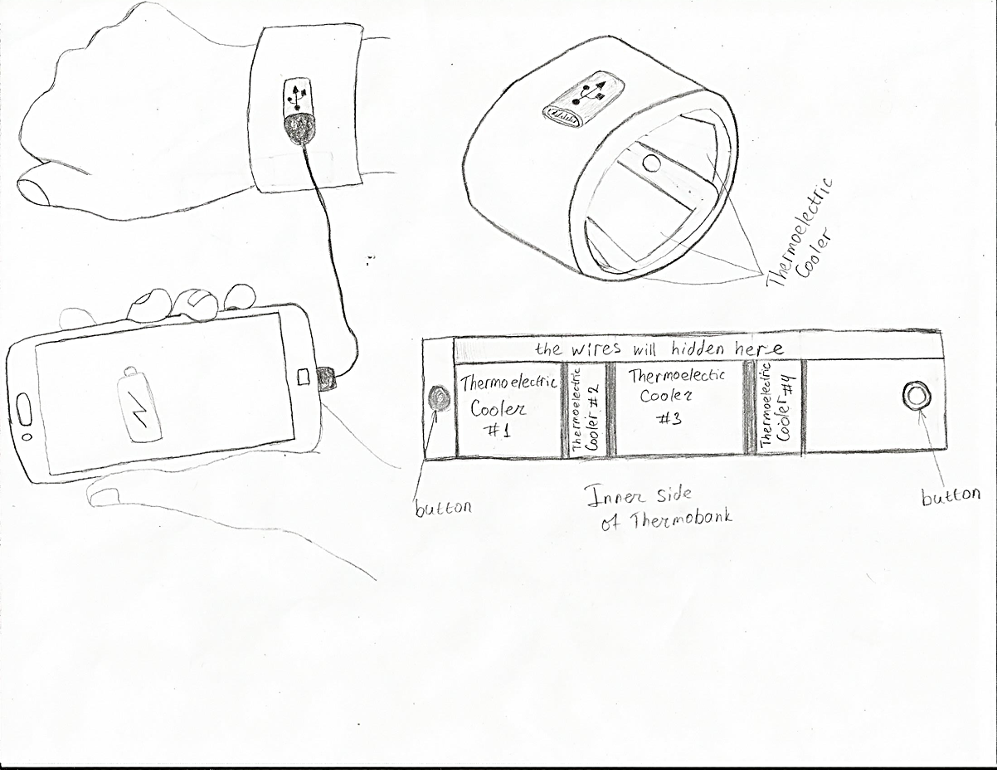
ThermoBank device
The initial concept of ThermoBank.
The secondary concept of ThermoBank.

Slide 4
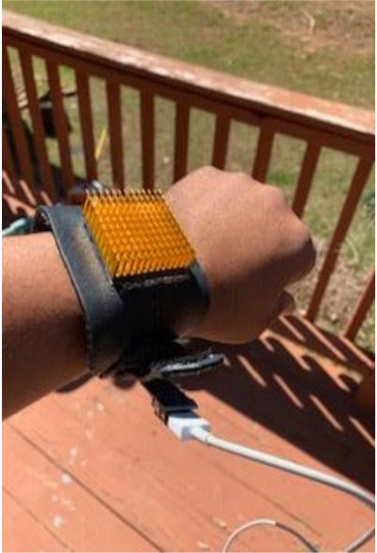
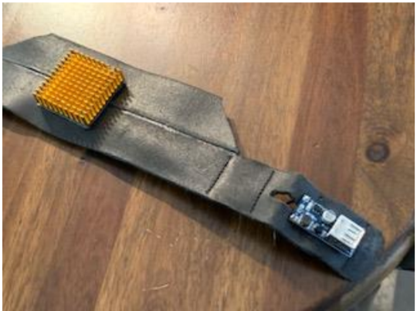
The first prototype of ThermoBank

Slide 5
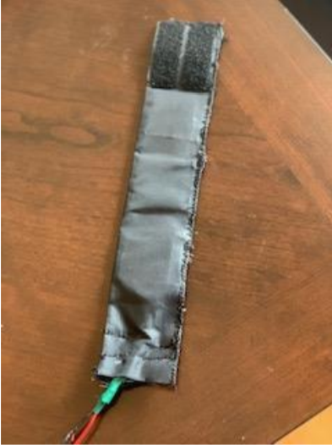
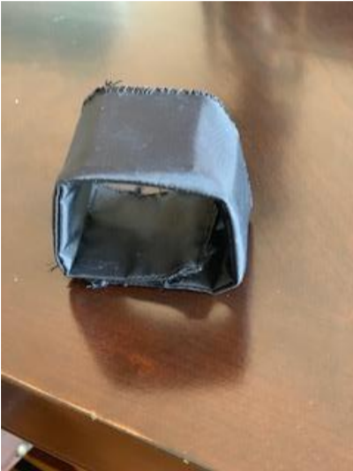
Final version of ThermoBank

Slide 6
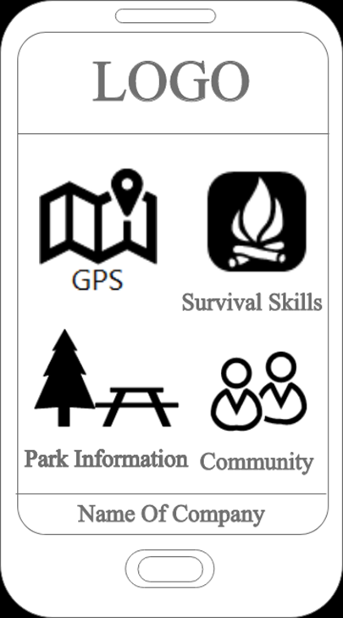
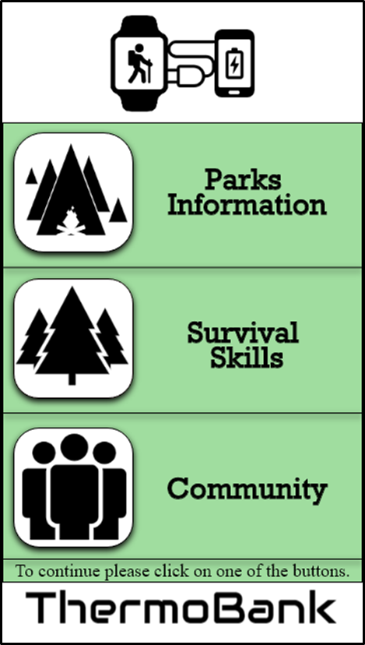
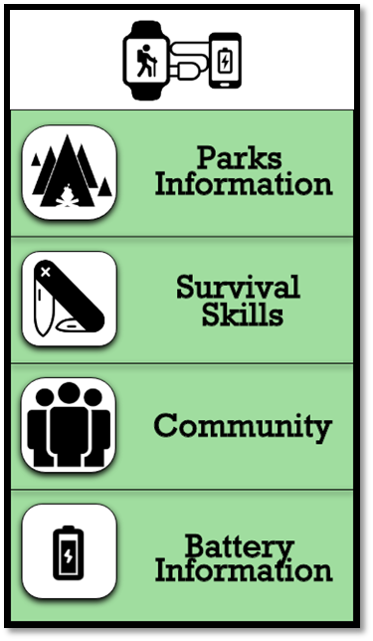
ThermoBank app
The initial concept
The secondary concept
The final concept

Slide 7
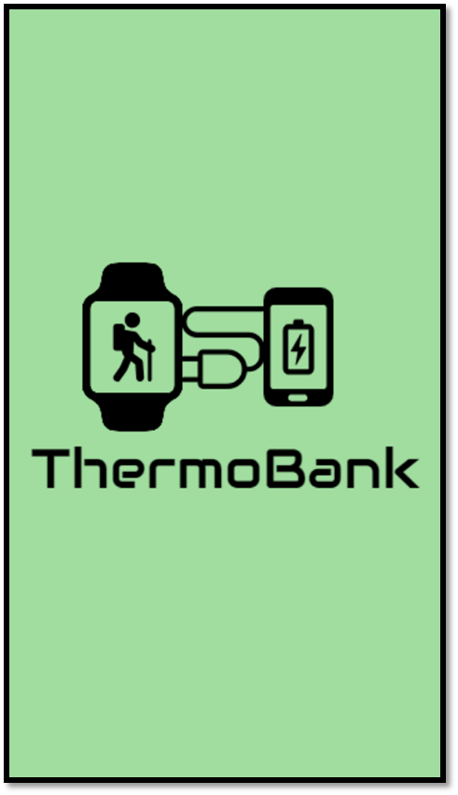
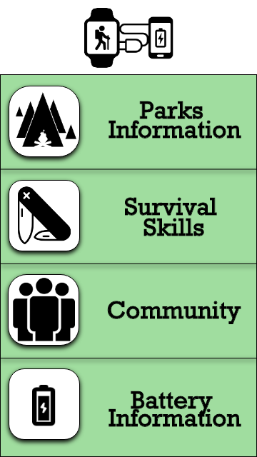
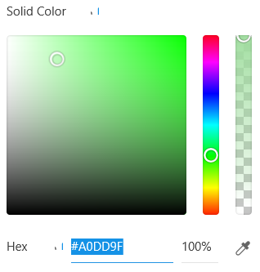
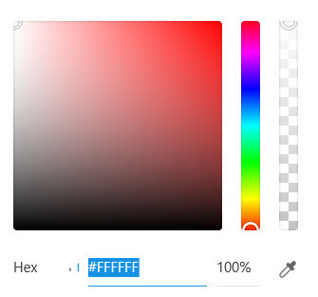
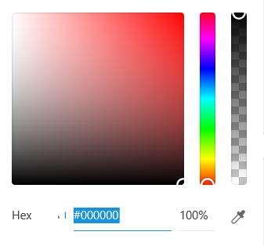
Visual Design

Slide 8
Usability Test of ThermoBank
Questions that we asked:
Can you easily locate the back button?
Can you easily understand what each icon represent?
Does the text is easy to read?
Does the process of registration was easy and understandable?

Slide 9
Usability Test of ThermoBank
Questions that we asked:
How do you feel wearing it?
What is the reason that it makes you feel uncomfortable?
What do you think about the size of the device?
Will you suggest to others to use it?

Slide 10
Changes
App
Less text
Relocation of back arrow button
Change of survival skill icon
Device
Less loose
More comfortable

